Slide 1
Somaliland: a nation in transformation How the emerging technology is shaping our future
______________________________________________________________________________
Dr. Jama Musse Jama
Somaliland ICT Conference 2020
15 November 2020
__________________________________________________________
Jama Musse Jama | jama@redsea-online.org | twitter @JamaMusse
www.hargeysaculturalcentre.org
Notes:
Thank you: I expect to learn what you are doing for the corpus in Ethiopian Languages, including the Somali. We will be happy to contribute and put forces together, at least for the Somali language.

Slide 2
#SLICTC2020 @JamaMusse @MinistryofICT1
______________________________________________________________________________
Somaliland: a nation in transformation How the emerging technology is shaping our future
__________________________________________________________
Jama Musse Jama | jama@redsea-online.org | twitter @JamaMusse
www.hargeysaculturalcentre.org
Notes:
Thank you: I expect to learn what you are doing for the corpus in Ethiopian Languages, including the Somali. We will be happy to contribute and put forces together, at least for the Somali language.

Slide 3
Somaliland: a nation in transformation
What is the Fourth Industrial Revolution?
__________________________________________________________
Jama Musse Jama | jama@redsea-online.org | twitter @JamaMusse
www.hargeysaculturalcentre.org
Notes:
Thank you: I expect to learn what you are doing for the corpus in Ethiopian Languages, including the Somali. We will be happy to contribute and put forces together, at least for the Somali language.

Slide 4
Somaliland: a nation in transformation
What is the Fourth Industrial Revolution?
Rethinking Relevance in Knowledge Production in Africa
__________________________________________________________
Jama Musse Jama | jama@redsea-online.org | twitter @JamaMusse
www.hargeysaculturalcentre.org
Notes:
Thank you: I expect to learn what you are doing for the corpus in Ethiopian Languages, including the Somali. We will be happy to contribute and put forces together, at least for the Somali language.

Slide 5
Somaliland: a nation in transformation
What is the Fourth Industrial Revolution?
Rethinking Relevance in Knowledge Production in Africa
Women in technology
__________________________________________________________
Jama Musse Jama | jama@redsea-online.org | twitter @JamaMusse
www.hargeysaculturalcentre.org
Notes:
Thank you: I expect to learn what you are doing for the corpus in Ethiopian Languages, including the Somali. We will be happy to contribute and put forces together, at least for the Somali language.

Slide 6
Somaliland: a nation in transformation
What is the Fourth Industrial Revolution?
Rethinking Relevance in Knowledge Production in Africa
Women in technology
Localizing the knowledge
__________________________________________________________
Jama Musse Jama | jama@redsea-online.org | twitter @JamaMusse
www.hargeysaculturalcentre.org
Notes:
Thank you: I expect to learn what you are doing for the corpus in Ethiopian Languages, including the Somali. We will be happy to contribute and put forces together, at least for the Somali language.

Slide 7
Somaliland: a nation in transformation
What is the Fourth Industrial Revolution?
Rethinking Relevance in Knowledge Production in Africa
Women in technology
Localizing the knowledge
Localizing the use of ICT
__________________________________________________________
Jama Musse Jama | jama@redsea-online.org | twitter @JamaMusse
www.hargeysaculturalcentre.org
Notes:
Thank you: I expect to learn what you are doing for the corpus in Ethiopian Languages, including the Somali. We will be happy to contribute and put forces together, at least for the Somali language.

Slide 8
Somaliland: a nation in transformation
What is the Fourth Industrial Revolution?
Rethinking Relevance in Knowledge Production in Africa
Women in technology
Localizing the knowledge
Localizing the use of ICT
Somaliland context
__________________________________________________________
Jama Musse Jama | jama@redsea-online.org | twitter @JamaMusse
www.hargeysaculturalcentre.org
Notes:
Thank you: I expect to learn what you are doing for the corpus in Ethiopian Languages, including the Somali. We will be happy to contribute and put forces together, at least for the Somali language.

Slide 9
Somaliland: a nation in transformation
What is the Fourth Industrial Revolution?
Rethinking Relevance in Knowledge Production in Africa
Women in technology
Localizing the knowledge
Localizing the use of ICT
Somaliland context
Examples
__________________________________________________________
Jama Musse Jama | jama@redsea-online.org | twitter @JamaMusse
www.hargeysaculturalcentre.org
Notes:
Thank you: I expect to learn what you are doing for the corpus in Ethiopian Languages, including the Somali. We will be happy to contribute and put forces together, at least for the Somali language.

Slide 10
Somaliland: a nation in transformation
1. What is the Fourth Industrial Revolution?
__________________________________________________________
Jama Musse Jama | jama@redsea-online.org | twitter @JamaMusse
www.hargeysaculturalcentre.org
Notes:
Thank you: I expect to learn what you are doing for the corpus in Ethiopian Languages, including the Somali. We will be happy to contribute and put forces together, at least for the Somali language.

Slide 11
Somaliland: a nation in transformation
The Fourth Industrial Revolution, also known as Industry 4.0, involves the adoption of cyber-physical systems like the Internet of Things (IoT) and Internet of Systems (IoS)
__________________________________________________________
Jama Musse Jama | jama@redsea-online.org | twitter @JamaMusse
www.hargeysaculturalcentre.org
Notes:
Thank you: I expect to learn what you are doing for the corpus in Ethiopian Languages, including the Somali. We will be happy to contribute and put forces together, at least for the Somali language.

Slide 12
The 4th Revolution
_______________________________________
Dr. Jama Musse Jama | jama@redsea-online.org| 2020 – twitter: @JamaMusse
Xarunta Dhaqanka ee Hargeysa | Hargeysa Cultural Centre
Notes:
There should be a reason to build a corpus. A single corpus cannot be valid for all reasons, and multi-purpose corpora always showed less helpful for the specific research in computational linguistics.

Slide 13
Internet of things (IoT)
_______________________________________
Dr. Jama Musse Jama | jama@redsea-online.org| 2020 – twitter: @JamaMusse
Xarunta Dhaqanka ee Hargeysa | Hargeysa Cultural Centre
Notes:
There should be a reason to build a corpus. A single corpus cannot be valid for all reasons, and multi-purpose corpora always showed less helpful for the specific research in computational linguistics.

Slide 14
Internet of systems (IoS)
_______________________________________
Dr. Jama Musse Jama | jama@redsea-online.org| 2020 – twitter: @JamaMusse
Xarunta Dhaqanka ee Hargeysa | Hargeysa Cultural Centre
Notes:
There should be a reason to build a corpus. A single corpus cannot be valid for all reasons, and multi-purpose corpora always showed less helpful for the specific research in computational linguistics.

Slide 15
Smart devices
_______________________________________
Dr. Jama Musse Jama | jama@redsea-online.org| 2020 – twitter: @JamaMusse
Xarunta Dhaqanka ee Hargeysa | Hargeysa Cultural Centre
Notes:
There should be a reason to build a corpus. A single corpus cannot be valid for all reasons, and multi-purpose corpora always showed less helpful for the specific research in computational linguistics.

Slide 16
The fourth revolution is driven by
4th Industrial revolution
_______________________________________
Dr. Jama Musse Jama | jama@redsea-online.org| 2020 – twitter: @JamaMusse
Xarunta Dhaqanka ee Hargeysa | Hargeysa Cultural Centre
Notes:
There should be a reason to build a corpus. A single corpus cannot be valid for all reasons, and multi-purpose corpora always showed less helpful for the specific research in computational linguistics.

Slide 17
The fourth revolution is driven by
High speed internet
4th Industrial revolution
_______________________________________
Dr. Jama Musse Jama | jama@redsea-online.org| 2020 – twitter: @JamaMusse
Xarunta Dhaqanka ee Hargeysa | Hargeysa Cultural Centre
Notes:
There should be a reason to build a corpus. A single corpus cannot be valid for all reasons, and multi-purpose corpora always showed less helpful for the specific research in computational linguistics.

Slide 18
The fourth revolution is driven by
High speed internet
4th Industrial revolution
AI and automation
_______________________________________
Dr. Jama Musse Jama | jama@redsea-online.org| 2020 – twitter: @JamaMusse
Xarunta Dhaqanka ee Hargeysa | Hargeysa Cultural Centre
Notes:
There should be a reason to build a corpus. A single corpus cannot be valid for all reasons, and multi-purpose corpora always showed less helpful for the specific research in computational linguistics.

Slide 19
The fourth revolution is driven by
Big data analysis
High speed internet
4th Industrial revolution
AI and automation
_______________________________________
Dr. Jama Musse Jama | jama@redsea-online.org| 2020 – twitter: @JamaMusse
Xarunta Dhaqanka ee Hargeysa | Hargeysa Cultural Centre
Notes:
There should be a reason to build a corpus. A single corpus cannot be valid for all reasons, and multi-purpose corpora always showed less helpful for the specific research in computational linguistics.

Slide 20
The fourth revolution is driven by
Big data analysis
High speed internet
4th Industrial revolution
Cloud technology
AI and automation
_______________________________________
Dr. Jama Musse Jama | jama@redsea-online.org| 2020 – twitter: @JamaMusse
Xarunta Dhaqanka ee Hargeysa | Hargeysa Cultural Centre
Notes:
There should be a reason to build a corpus. A single corpus cannot be valid for all reasons, and multi-purpose corpora always showed less helpful for the specific research in computational linguistics.

Slide 21
Somaliland: a nation in transformation
2. Rethinking Relevance in Knowledge Production in Africa
__________________________________________________________
Jama Musse Jama | jama@redsea-online.org | twitter @JamaMusse
www.hargeysaculturalcentre.org
Notes:
Thank you: I expect to learn what you are doing for the corpus in Ethiopian Languages, including the Somali. We will be happy to contribute and put forces together, at least for the Somali language.

Slide 22
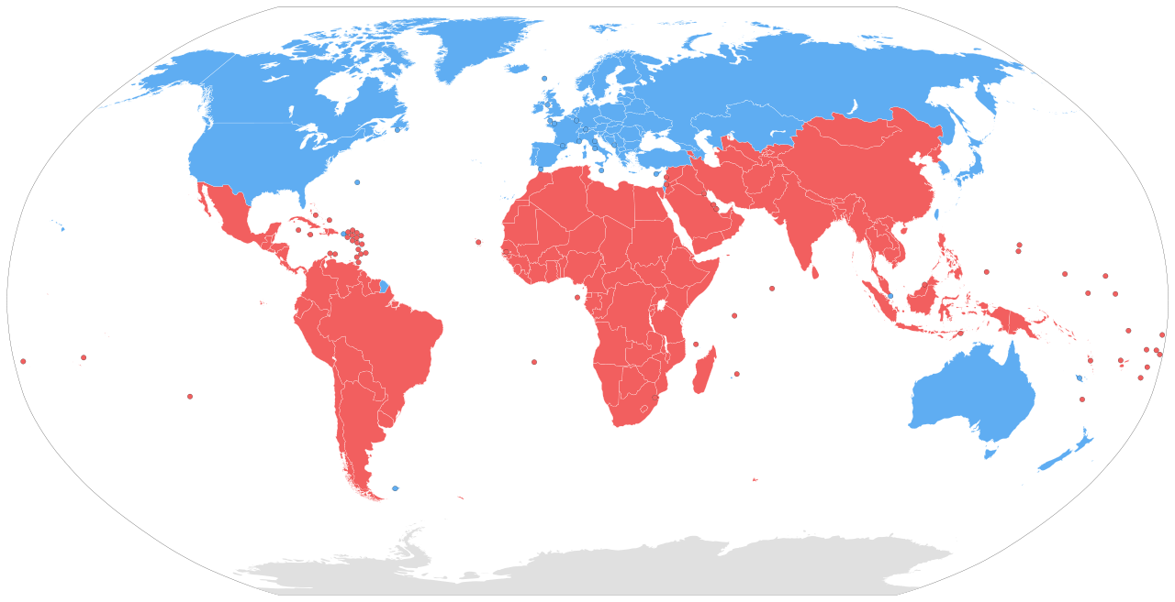
Somaliland: a nation in transformation
_______________________________________
Dr. Jama Musse Jama | jama@redsea-online.org| 2019
Xarunta Dhaqanka ee Hargeysa | Hargeysa Cultural Centre
Notes:
There should be a reason to build a corpus. A single corpus cannot be valid for all reasons, and multi-purpose corpora always showed less helpful for the specific research in computational linguistics.

Slide 23
Somaliland: a nation in transformation
Rethinking Relevance in Knowledge Production in Africa:
an argument for a paradigm shift towards an enabling environment.
Freedom:
_______________________________________
Dr. Jama Musse Jama | jama@redsea-online.org| 2019
Xarunta Dhaqanka ee Hargeysa | Hargeysa Cultural Centre
Notes:
There should be a reason to build a corpus. A single corpus cannot be valid for all reasons, and multi-purpose corpora always showed less helpful for the specific research in computational linguistics.

Slide 24
Somaliland: a nation in transformation
Rethinking Relevance in Knowledge Production in Africa:
an argument for a paradigm shift towards an enabling environment.
Freedom:
unable
_______________________________________
Dr. Jama Musse Jama | jama@redsea-online.org| 2019
Xarunta Dhaqanka ee Hargeysa | Hargeysa Cultural Centre
Notes:
There should be a reason to build a corpus. A single corpus cannot be valid for all reasons, and multi-purpose corpora always showed less helpful for the specific research in computational linguistics.

Slide 25
Somaliland: a nation in transformation
Rethinking Relevance in Knowledge Production in Africa:
an argument for a paradigm shift towards an enabling environment.
Freedom:
unable
To deliver
_______________________________________
Dr. Jama Musse Jama | jama@redsea-online.org| 2019
Xarunta Dhaqanka ee Hargeysa | Hargeysa Cultural Centre
Notes:
There should be a reason to build a corpus. A single corpus cannot be valid for all reasons, and multi-purpose corpora always showed less helpful for the specific research in computational linguistics.

Slide 26
Somaliland: a nation in transformation
Rethinking Relevance in Knowledge Production in Africa:
an argument for a paradigm shift towards an enabling environment.
Global Challenges
Freedom:
unable
To deliver
_______________________________________
Dr. Jama Musse Jama | jama@redsea-online.org| 2019
Xarunta Dhaqanka ee Hargeysa | Hargeysa Cultural Centre
Notes:
There should be a reason to build a corpus. A single corpus cannot be valid for all reasons, and multi-purpose corpora always showed less helpful for the specific research in computational linguistics.

Slide 27
Somaliland: a nation in transformation
Rethinking Relevance in Knowledge Production in Africa:
an argument for a paradigm shift towards an enabling environment.
Global Challenges
Global North
Freedom:
unable
To deliver
_______________________________________
Dr. Jama Musse Jama | jama@redsea-online.org| 2019
Xarunta Dhaqanka ee Hargeysa | Hargeysa Cultural Centre
Notes:
There should be a reason to build a corpus. A single corpus cannot be valid for all reasons, and multi-purpose corpora always showed less helpful for the specific research in computational linguistics.

Slide 28
Somaliland: a nation in transformation
Rethinking Relevance in Knowledge Production in Africa:
an argument for a paradigm shift towards an enabling environment.
Global Challenges
Global North
Global South
Freedom:
unable
To deliver
_______________________________________
Dr. Jama Musse Jama | jama@redsea-online.org| 2019
Xarunta Dhaqanka ee Hargeysa | Hargeysa Cultural Centre
Notes:
There should be a reason to build a corpus. A single corpus cannot be valid for all reasons, and multi-purpose corpora always showed less helpful for the specific research in computational linguistics.

Slide 29
Somaliland: a nation in transformation
Rethinking Relevance in Knowledge Production in Africa:
an argument for a paradigm shift towards an enabling environment.
Knowledge production
Global Challenges
Global North
Global South
Freedom:
unable
To deliver
_______________________________________
Dr. Jama Musse Jama | jama@redsea-online.org| 2019
Xarunta Dhaqanka ee Hargeysa | Hargeysa Cultural Centre
Notes:
There should be a reason to build a corpus. A single corpus cannot be valid for all reasons, and multi-purpose corpora always showed less helpful for the specific research in computational linguistics.

Slide 30
Somaliland: a nation in transformation
Rethinking Relevance in Knowledge Production in Africa:
an argument for a paradigm shift towards an enabling environment.
Knowledge production
Collaboration Equivalence
Global Challenges
Global North
Global South
Freedom:
unable
To deliver
_______________________________________
Dr. Jama Musse Jama | jama@redsea-online.org| 2019
Xarunta Dhaqanka ee Hargeysa | Hargeysa Cultural Centre
Notes:
There should be a reason to build a corpus. A single corpus cannot be valid for all reasons, and multi-purpose corpora always showed less helpful for the specific research in computational linguistics.

Slide 31
Somaliland: a nation in transformation
Enabling Environment
_______________________________________
Dr. Jama Musse Jama | jama@redsea-online.org| 2019
Xarunta Dhaqanka ee Hargeysa | Hargeysa Cultural Centre
Notes:
There should be a reason to build a corpus. A single corpus cannot be valid for all reasons, and multi-purpose corpora always showed less helpful for the specific research in computational linguistics.

Slide 32
Somaliland: a nation in transformation
3. Women in technology
__________________________________________________________
Jama Musse Jama | jama@redsea-online.org | twitter @JamaMusse
www.hargeysaculturalcentre.org
Notes:
Thank you: I expect to learn what you are doing for the corpus in Ethiopian Languages, including the Somali. We will be happy to contribute and put forces together, at least for the Somali language.

Slide 33
Somaliland: a nation in transformation
Women in technology
Long way to go in Somaliland
__________________________________________________________
Jama Musse Jama | jama@redsea-online.org | twitter @JamaMusse
www.hargeysaculturalcentre.org
Notes:
Thank you: I expect to learn what you are doing for the corpus in Ethiopian Languages, including the Somali. We will be happy to contribute and put forces together, at least for the Somali language.

Slide 34
Somaliland: a nation in transformation
Women in technology
Long way to go in Somaliland
Girls empowerment
__________________________________________________________
Jama Musse Jama | jama@redsea-online.org | twitter @JamaMusse
www.hargeysaculturalcentre.org
Notes:
Thank you: I expect to learn what you are doing for the corpus in Ethiopian Languages, including the Somali. We will be happy to contribute and put forces together, at least for the Somali language.

Slide 35
Somaliland: a nation in transformation
Women in technology
Long way to go in Somaliland
Girls empowerment
STEM
__________________________________________________________
Jama Musse Jama | jama@redsea-online.org | twitter @JamaMusse
www.hargeysaculturalcentre.org
Notes:
Thank you: I expect to learn what you are doing for the corpus in Ethiopian Languages, including the Somali. We will be happy to contribute and put forces together, at least for the Somali language.

Slide 36
Somaliland: a nation in transformation
Women in technology
Long way to go in Somaliland
Girls empowerment
STEM
What is not only for gender balance!
__________________________________________________________
Jama Musse Jama | jama@redsea-online.org | twitter @JamaMusse
www.hargeysaculturalcentre.org
Notes:
Thank you: I expect to learn what you are doing for the corpus in Ethiopian Languages, including the Somali. We will be happy to contribute and put forces together, at least for the Somali language.

Slide 37
Somaliland: a nation in transformation
Enabling Environment
_______________________________________
Dr. Jama Musse Jama | jama@redsea-online.org| 2019
Xarunta Dhaqanka ee Hargeysa | Hargeysa Cultural Centre
Notes:
There should be a reason to build a corpus. A single corpus cannot be valid for all reasons, and multi-purpose corpora always showed less helpful for the specific research in computational linguistics.

Slide 38
Somaliland: a nation in transformation
Enabling Environment
Collaboration of equivalence
_______________________________________
Dr. Jama Musse Jama | jama@redsea-online.org| 2019
Xarunta Dhaqanka ee Hargeysa | Hargeysa Cultural Centre
Notes:
There should be a reason to build a corpus. A single corpus cannot be valid for all reasons, and multi-purpose corpora always showed less helpful for the specific research in computational linguistics.

Slide 39
Somaliland: a nation in transformation
Enabling Environment
Select qualified
Collaboration of equivalence
_______________________________________
Dr. Jama Musse Jama | jama@redsea-online.org| 2019
Xarunta Dhaqanka ee Hargeysa | Hargeysa Cultural Centre
Notes:
There should be a reason to build a corpus. A single corpus cannot be valid for all reasons, and multi-purpose corpora always showed less helpful for the specific research in computational linguistics.

Slide 40
Somaliland: a nation in transformation
Sustain & keep quality
Enabling Environment
Select qualified
Collaboration of equivalence
_______________________________________
Dr. Jama Musse Jama | jama@redsea-online.org| 2019
Xarunta Dhaqanka ee Hargeysa | Hargeysa Cultural Centre
Notes:
There should be a reason to build a corpus. A single corpus cannot be valid for all reasons, and multi-purpose corpora always showed less helpful for the specific research in computational linguistics.

Slide 41
Somaliland: a nation in transformation
Sustain & keep quality
Enabling Environment
Select qualified
Appreciating local
Collaboration of equivalence
_______________________________________
Dr. Jama Musse Jama | jama@redsea-online.org| 2019
Xarunta Dhaqanka ee Hargeysa | Hargeysa Cultural Centre
Notes:
There should be a reason to build a corpus. A single corpus cannot be valid for all reasons, and multi-purpose corpora always showed less helpful for the specific research in computational linguistics.

Slide 42
Somaliland: a nation in transformation
Sustain & keep quality
Enabling Environment
Select qualified
lead
Appreciating local
Collaboration of equivalence
_______________________________________
Dr. Jama Musse Jama | jama@redsea-online.org| 2019
Xarunta Dhaqanka ee Hargeysa | Hargeysa Cultural Centre
Notes:
There should be a reason to build a corpus. A single corpus cannot be valid for all reasons, and multi-purpose corpora always showed less helpful for the specific research in computational linguistics.

Slide 43
Somaliland: a nation in transformation
Sustain & keep quality
Enabling Environment
Co-create
Select qualified
lead
Appreciating local
Collaboration of equivalence
_______________________________________
Dr. Jama Musse Jama | jama@redsea-online.org| 2019
Xarunta Dhaqanka ee Hargeysa | Hargeysa Cultural Centre
Notes:
There should be a reason to build a corpus. A single corpus cannot be valid for all reasons, and multi-purpose corpora always showed less helpful for the specific research in computational linguistics.

Slide 44
Somaliland: a nation in transformation
Co-produce
Sustain & keep quality
Enabling Environment
Co-create
Select qualified
lead
Appreciating local
Collaboration of equivalence
_______________________________________
Dr. Jama Musse Jama | jama@redsea-online.org| 2019
Xarunta Dhaqanka ee Hargeysa | Hargeysa Cultural Centre
Notes:
There should be a reason to build a corpus. A single corpus cannot be valid for all reasons, and multi-purpose corpora always showed less helpful for the specific research in computational linguistics.

Slide 45
Somaliland: a nation in transformation
Responsibility
Co-produce
Sustain & keep quality
Enabling Environment
Co-create
Select qualified
lead
Appreciating local
Collaboration of equivalence
_______________________________________
Dr. Jama Musse Jama | jama@redsea-online.org| 2019
Xarunta Dhaqanka ee Hargeysa | Hargeysa Cultural Centre
Notes:
There should be a reason to build a corpus. A single corpus cannot be valid for all reasons, and multi-purpose corpora always showed less helpful for the specific research in computational linguistics.

Slide 46
Somaliland: a nation in transformation
Responsibility
Co-produce
Sustain & keep quality
Enabling Environment
Co-create
Select qualified
lead
Appreciating local
Mutual trust
Collaboration of equivalence
_______________________________________
Dr. Jama Musse Jama | jama@redsea-online.org| 2019
Xarunta Dhaqanka ee Hargeysa | Hargeysa Cultural Centre
Notes:
There should be a reason to build a corpus. A single corpus cannot be valid for all reasons, and multi-purpose corpora always showed less helpful for the specific research in computational linguistics.

Slide 47
Somaliland: a nation in transformation
Responsibility
Co-produce
Sustain & keep quality
Enabling Environment
Co-create
Select qualified
Culturally sensitive
lead
Appreciating local
Mutual trust
Collaboration of equivalence
_______________________________________
Dr. Jama Musse Jama | jama@redsea-online.org| 2019
Xarunta Dhaqanka ee Hargeysa | Hargeysa Cultural Centre
Notes:
There should be a reason to build a corpus. A single corpus cannot be valid for all reasons, and multi-purpose corpora always showed less helpful for the specific research in computational linguistics.

Slide 48
Somaliland: a nation in transformation
Humility
Responsibility
Co-produce
Sustain & keep quality
Enabling Environment
Co-create
Select qualified
Culturally sensitive
lead
Appreciating local
Mutual trust
Collaboration of equivalence
_______________________________________
Dr. Jama Musse Jama | jama@redsea-online.org| 2019
Xarunta Dhaqanka ee Hargeysa | Hargeysa Cultural Centre
Notes:
There should be a reason to build a corpus. A single corpus cannot be valid for all reasons, and multi-purpose corpora always showed less helpful for the specific research in computational linguistics.

Slide 49
Somaliland: a nation in transformation
Self sustaining
Building our own system
Enabling Environment in Somaliland
South-South Collaboration
Local open source
Focusing on women in tech
_______________________________________
Dr. Jama Musse Jama | jama@redsea-online.org| 2019
Xarunta Dhaqanka ee Hargeysa | Hargeysa Cultural Centre
Notes:
There should be a reason to build a corpus. A single corpus cannot be valid for all reasons, and multi-purpose corpora always showed less helpful for the specific research in computational linguistics.

Slide 50
Somaliland: a nation in transformation
5. Localizing the knowledge:
Language,
Culture,
Knowledge production
__________________________________________________________
Jama Musse Jama | jama@redsea-online.org | twitter @JamaMusse
www.hargeysaculturalcentre.org
Notes:
Thank you: I expect to learn what you are doing for the corpus in Ethiopian Languages, including the Somali. We will be happy to contribute and put forces together, at least for the Somali language.

Slide 51
Somaliland: a nation in transformation
Localizing the use of ICT
IT, ICT, CS, STEM
__________________________________________________________
Jama Musse Jama | jama@redsea-online.org | twitter @JamaMusse
www.hargeysaculturalcentre.org
Notes:
Thank you: I expect to learn what you are doing for the corpus in Ethiopian Languages, including the Somali. We will be happy to contribute and put forces together, at least for the Somali language.

Slide 52
Somaliland: a nation in transformation
Localizing the use of ICT
IT, ICT, CS, STEM
Security, defense, justice, governance
__________________________________________________________
Jama Musse Jama | jama@redsea-online.org | twitter @JamaMusse
www.hargeysaculturalcentre.org
Notes:
Thank you: I expect to learn what you are doing for the corpus in Ethiopian Languages, including the Somali. We will be happy to contribute and put forces together, at least for the Somali language.

Slide 53
Somaliland: a nation in transformation
6. Somaliland context
__________________________________________________________
Jama Musse Jama | jama@redsea-online.org | twitter @JamaMusse
www.hargeysaculturalcentre.org
Notes:
Thank you: I expect to learn what you are doing for the corpus in Ethiopian Languages, including the Somali. We will be happy to contribute and put forces together, at least for the Somali language.

Slide 54
Role of culture
Examples in mathematics
_______________________________________
Jama Musse Jama | jama@jamamusse.com | 2016
Xarunta Dhaqanka ee Hargeysa | Hargeysa Cultural Centre
Notes:
150 years ago – proofed only 1976 – Augustus De Morgan (1806-1871)

Slide 55
Role of culture
Examples in mathematics
Probability
Calculus
_______________________________________
Jama Musse Jama | jama@jamamusse.com | 2016
Xarunta Dhaqanka ee Hargeysa | Hargeysa Cultural Centre
Notes:
Let us focus on Itimaal and Kalkulas

Slide 56
Role of culture
Examples in mathematics
Probability
Examples
Cards example
Game of dice
Calculus
_______________________________________
Jama Musse Jama | jama@jamamusse.com | 2016
Xarunta Dhaqanka ee Hargeysa | Hargeysa Cultural Centre
Notes:
Dadku waxay u haystaan turubka diin la’aan. Afrikana maba taqaan turub

Slide 57
Role of culture
Examples in mathematics
Probability
Examples
Cards example
Game of dice
Calculus
Zeno’s Paradox
Achilles and the tortoise
_______________________________________
Jama Musse Jama | jama@jamamusse.com | 2016
Xarunta Dhaqanka ee Hargeysa | Hargeysa Cultural Centre
Notes:
Set of philosophical problems generally beileived that the Greek philosopher Zeno of Elea (ca. 490-430 BC). Mathematicians then took series the issue and defined set of problems. Proof of contradiction. (In a race, the quickest runner can never overtake the slowest, since the pursuer must first reach the point whence the pursued started, so that the slower must always hold a lead. – as recounted by Aristotle, Physics VI:9, 239b15)

Slide 58
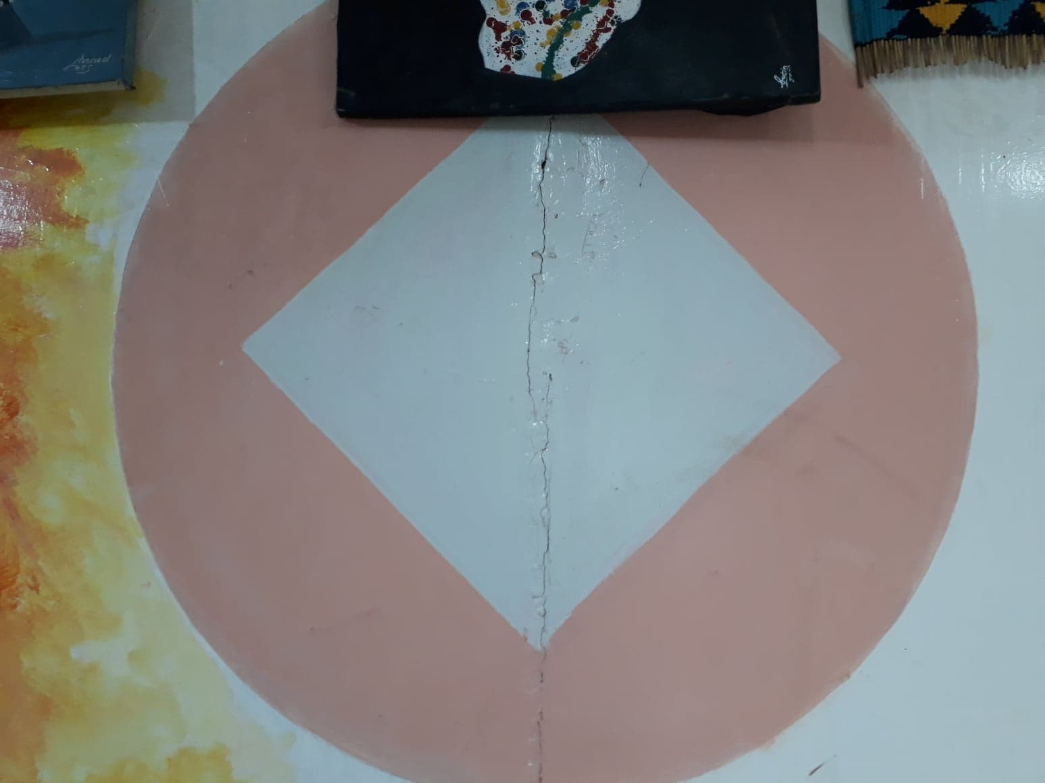
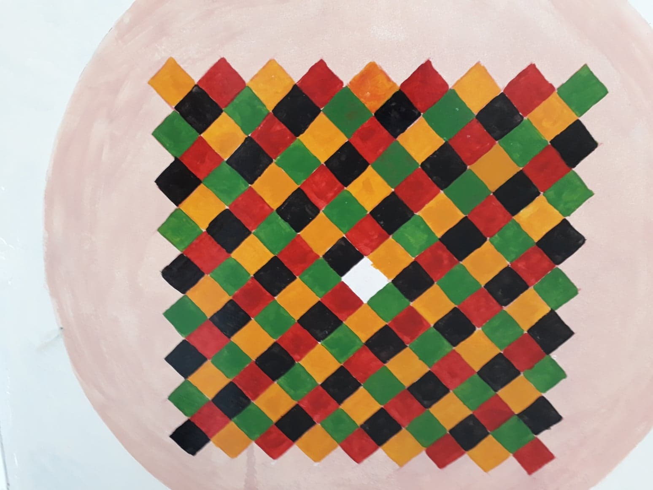
Role of culture
Examples in mathematics
_______________________________________
Jama Musse Jama | jama@jamamusse.com | 2016
Xarunta Dhaqanka ee Hargeysa | Hargeysa Cultural Centre
Notes:
150 years ago – proofed only 1976 – Augustus De Morgan (1806-1871)

Slide 59
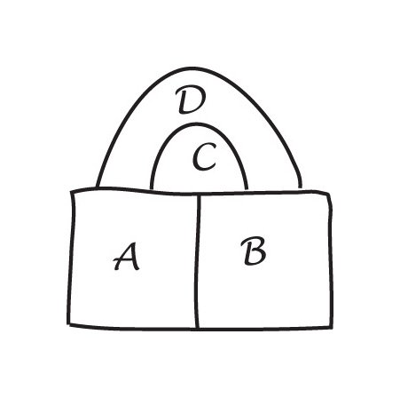
Role of culture
Examples in mathematics
_______________________________________
Jama Musse Jama | jama@jamamusse.com | 2016
Xarunta Dhaqanka ee Hargeysa | Hargeysa Cultural Centre
Notes:
150 years ago – proofed only 1976 – Augustus De Morgan (1806-1871)

Slide 60
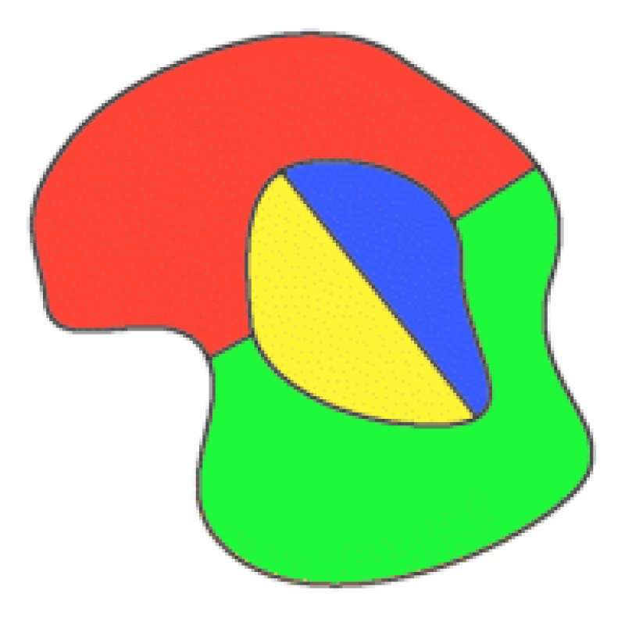
Role of culture
Examples in mathematics
_______________________________________
Jama Musse Jama | jama@jamamusse.com | 2016
Xarunta Dhaqanka ee Hargeysa | Hargeysa Cultural Centre
Notes:
150 years ago – proofed only 1976 – Augustus De Morgan (1806-1871)

Slide 61
Role of culture
Examples in mathematics
_______________________________________
Jama Musse Jama | jama@jamamusse.com | 2016
Xarunta Dhaqanka ee Hargeysa | Hargeysa Cultural Centre
Notes:
150 years ago – proofed only 1976 – Augustus De Morgan (1806-1871)

Slide 62
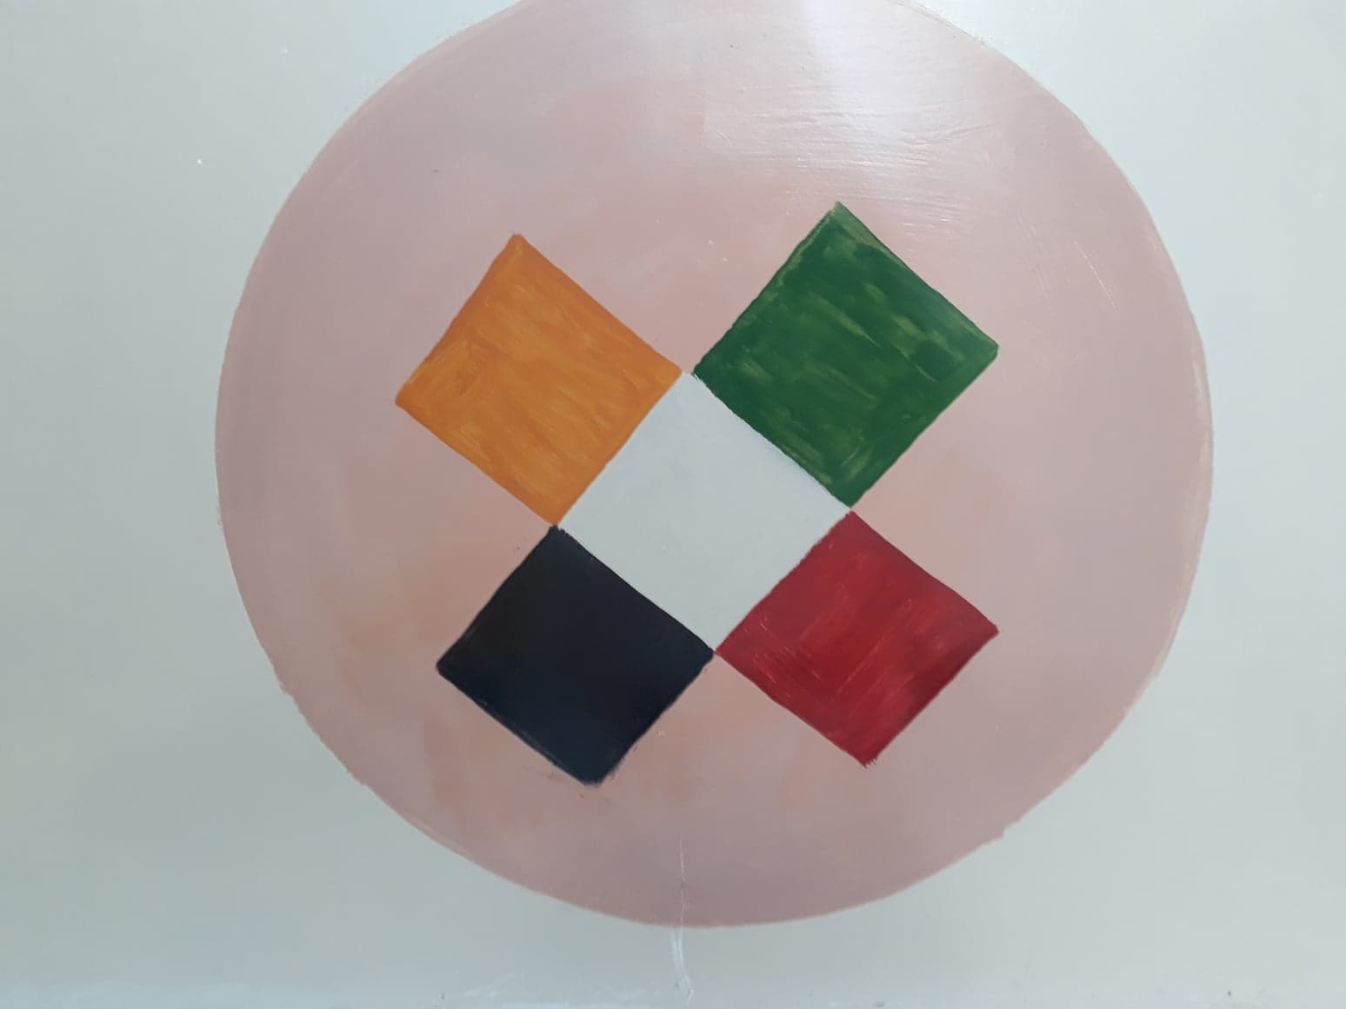
Role of culture
Examples in mathematics
_______________________________________
Jama Musse Jama | jama@jamamusse.com | 2016
Xarunta Dhaqanka ee Hargeysa | Hargeysa Cultural Centre
Notes:
150 years ago – proofed only 1976 – Augustus De Morgan (1806-1871)

Slide 63
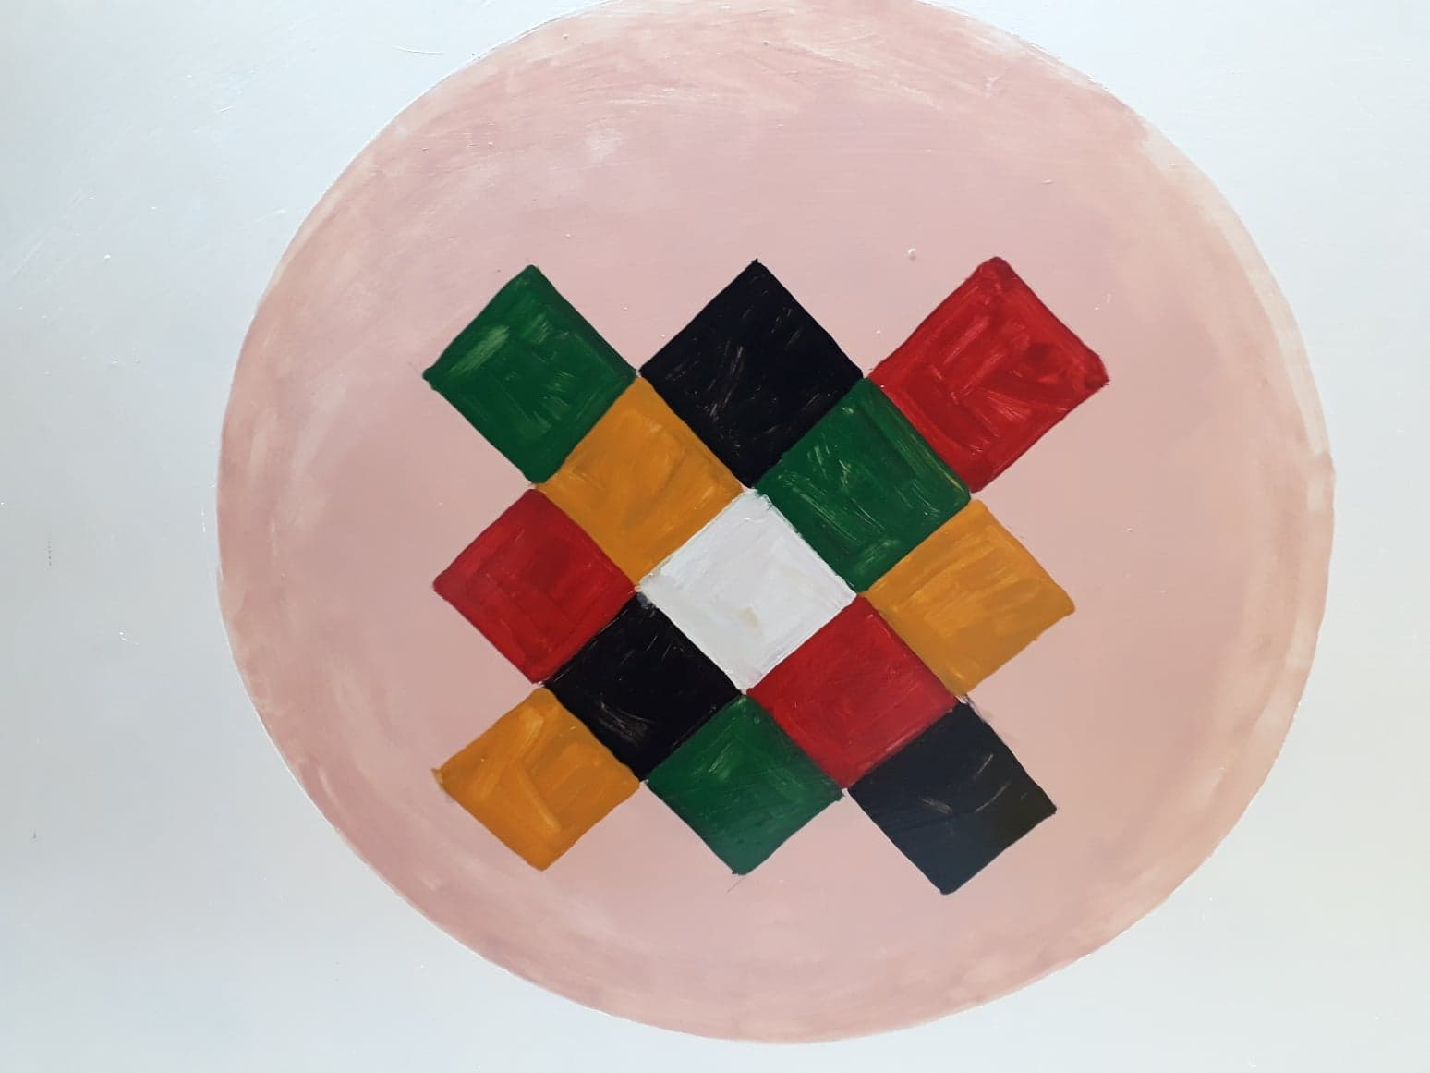
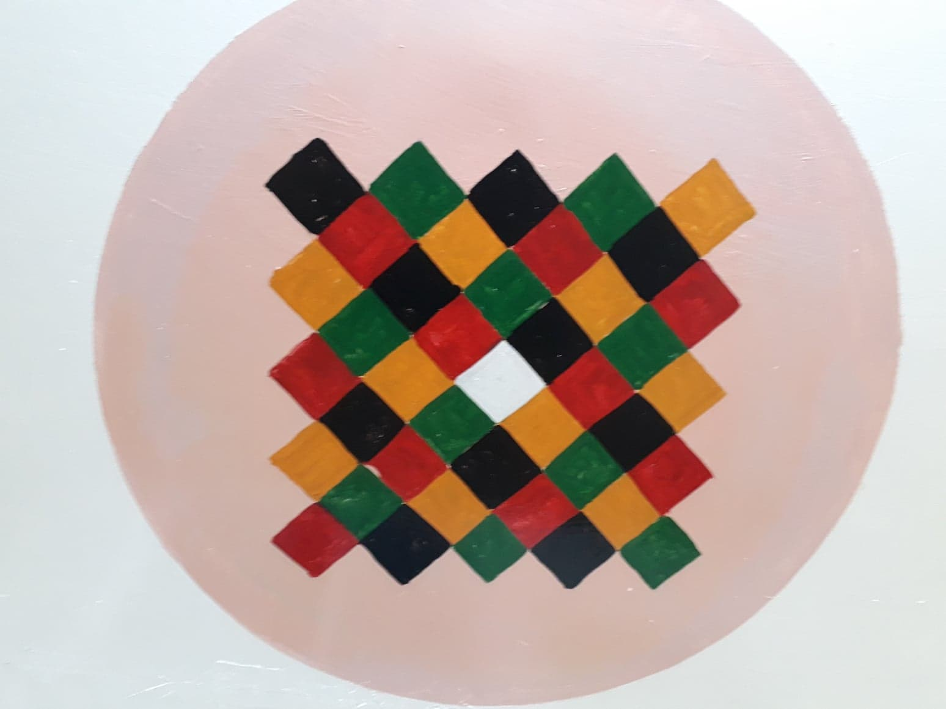
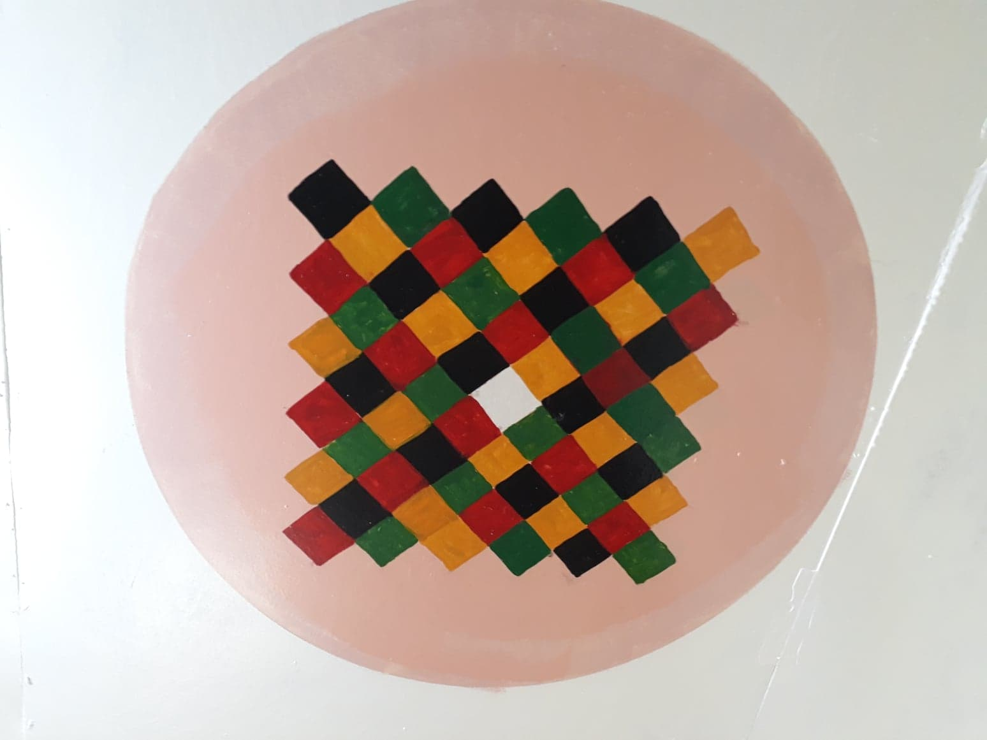
Role of culture
Examples in mathematics
_______________________________________
Jama Musse Jama | jama@jamamusse.com | 2016
Xarunta Dhaqanka ee Hargeysa | Hargeysa Cultural Centre
Notes:
150 years ago – proofed only 1976 – Augustus De Morgan (1806-1871)

Slide 64
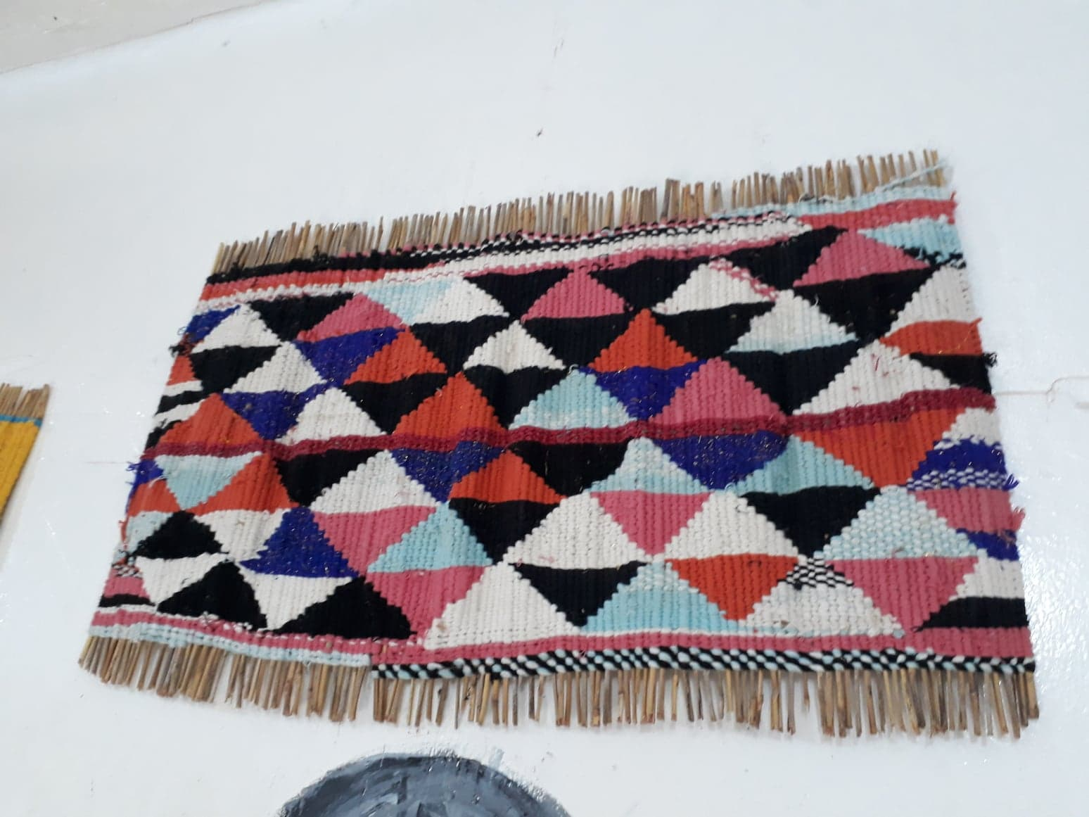
Role of culture
Examples in mathematics
_______________________________________
Jama Musse Jama | jama@jamamusse.com | 2016
Xarunta Dhaqanka ee Hargeysa | Hargeysa Cultural Centre
Notes:
150 years ago – proofed only 1976 – Augustus De Morgan (1806-1871)

Slide 65
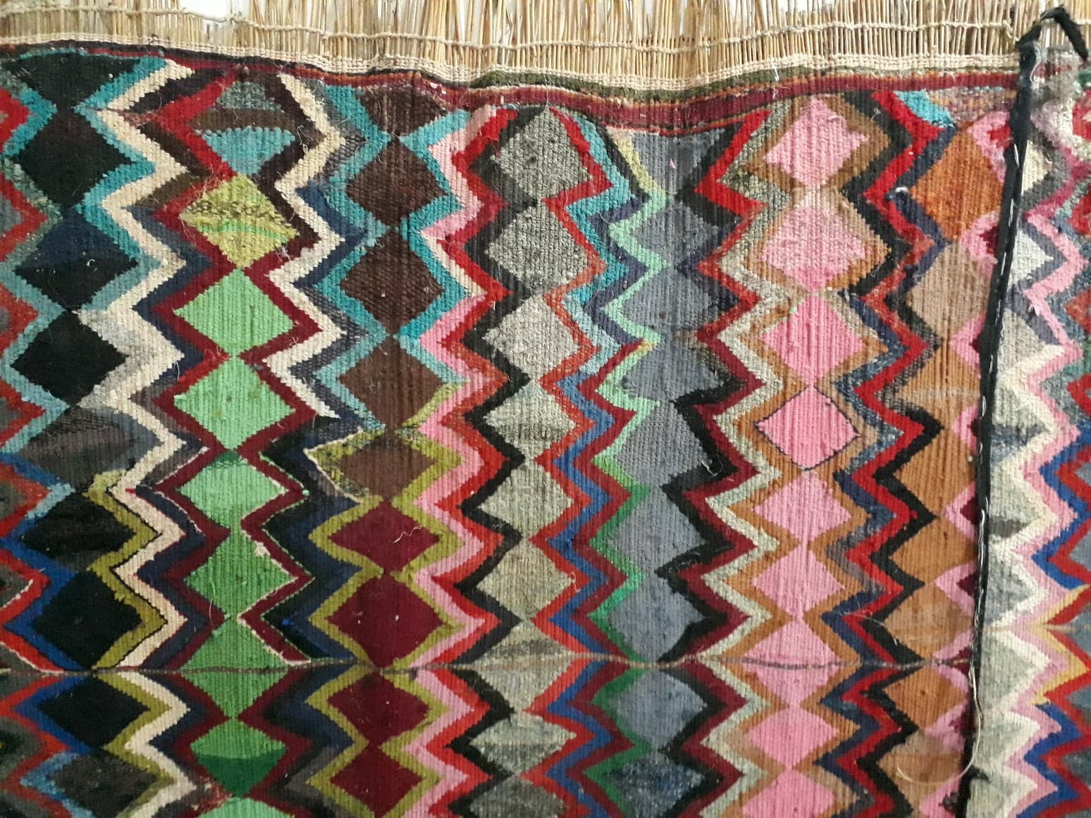
Role of culture
Examples in mathematics
_______________________________________
Jama Musse Jama | jama@jamamusse.com | 2016
Xarunta Dhaqanka ee Hargeysa | Hargeysa Cultural Centre
Notes:
150 years ago – proofed only 1976 – Augustus De Morgan (1806-1871)

Slide 66
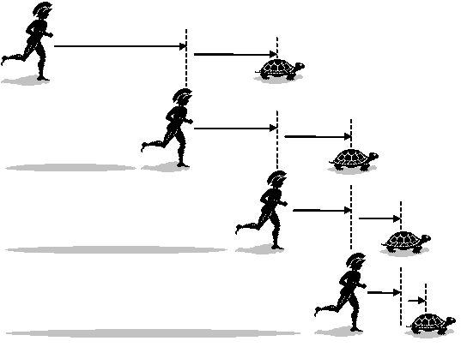
Role of culture
Examples in mathematics
_______________________________________
Jama Musse Jama | jama@jamamusse.com | 2016
Xarunta Dhaqanka ee Hargeysa | Hargeysa Cultural Centre
Notes:
150 years ago – proofed only 1976 – Augustus De Morgan (1806-1871)

Slide 67
Ethnomathematics
Zeno’s paradox in Somali
_______________________________________
Jama Musse Jama | jama@jamamusse.com | 2016
Xarunta Dhaqanka ee Hargeysa | Hargeysa Cultural Centre

Slide 68
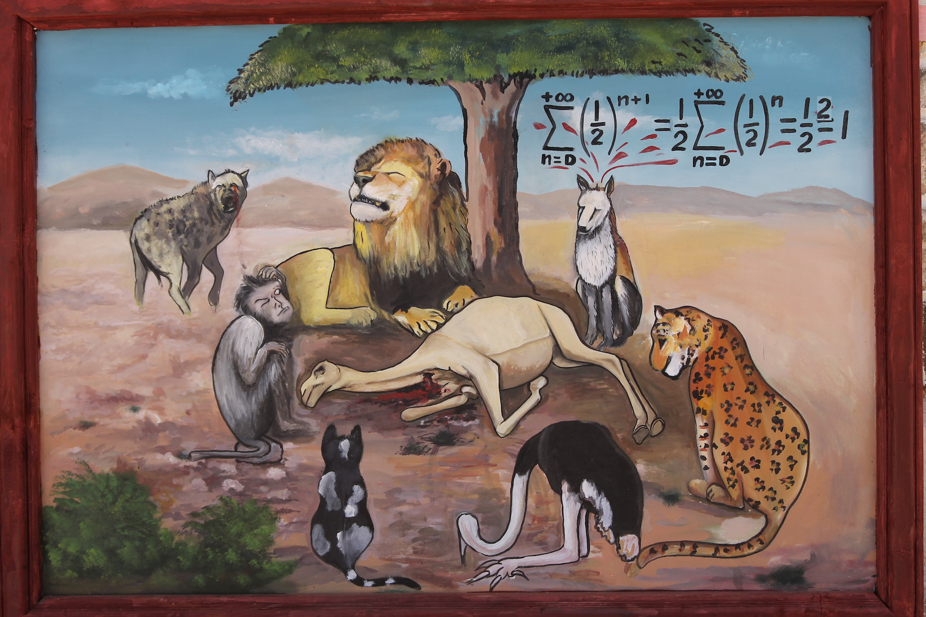
Ethnomathematics
_______________________________________
Jama Musse Jama | jama@jamamusse.com | 2016
Xarunta Dhaqanka ee Hargeysa | Hargeysa Cultural Centre

Slide 69
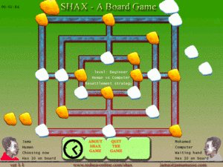
Ethnomathematics
Using games to teach basic mathematics
_______________________________________
Jama Musse Jama | jama@jamamusse.com | 2016
Xarunta Dhaqanka ee Hargeysa | Hargeysa Cultural Centre

Slide 70
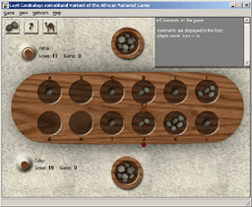
Ethnomathematics
Using games to teach basic mathematics
_______________________________________
Jama Musse Jama | jama@jamamusse.com | 2016
Xarunta Dhaqanka ee Hargeysa | Hargeysa Cultural Centre

Slide 71
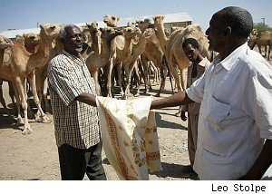
Ethnomathematics
Bargaining in Burco
_______________________________________
Jama Musse Jama | jama@jamamusse.com | 2016
Xarunta Dhaqanka ee Hargeysa | Hargeysa Cultural Centre
Notes:
Here it goes

Slide 72
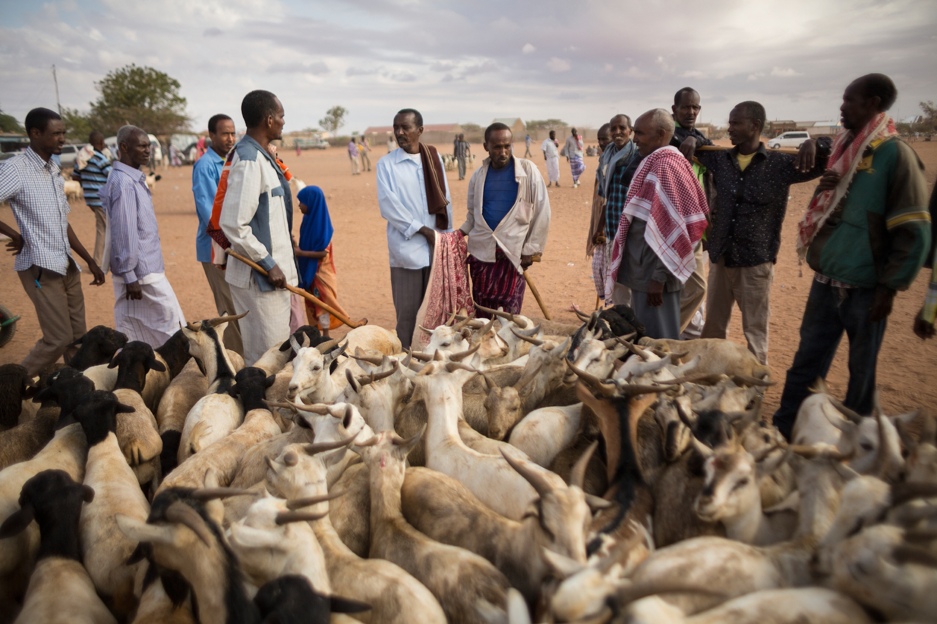
Ethnomathematics
Bargaining in Burco
_______________________________________
Jama Musse Jama | jama@jamamusse.com | 2016
Xarunta Dhaqanka ee Hargeysa | Hargeysa Cultural Centre
Notes:
Here it goes

Slide 73
Tools for teaching
Teaching in a culturally sensitive way
Producing knowledge that makes sense of your own people
_______________________________________
Jama Musse Jama | jama@jamamusse.com | 2016
Xarunta Dhaqanka ee Hargeysa | Hargeysa Cultural Centre
Notes:
Here it goes

Slide 74
______________________________________________________________________________
One example: Somali Corpus
__________________________________________________________
Jama Musse Jama | jama@redsea-online.org | twitter @JamaMusse
www.hargeysaculturalcentre.org
Notes:
Thank you: I expect to learn what you are doing for the corpus in Ethiopian Languages, including the Somali. We will be happy to contribute and put forces together, at least for the Somali language.

Slide 75
Somali Corpus: towards 7 million words tagged
______________________________________________________________________________
New research insights
__________________________________________________________
Jama Musse Jama | jama@jamamusse.com
www.hargeysaculturalcentre.org
Notes:
Thank you: I expect to learn what you are doing for the corpus in Ethiopian Languages, including the Somali. We will be happy to contribute and put forces together, at least for the Somali language.

Slide 76
Corpus of Somali Language
Aim: building a corpus (which and for what?)
Development: structure and the platform
The corpus: anticipated results
Interaction: tools for managing and using
IT Applications developed
_______________________________________
Jama Musse Jama | jama@jamamusse.com | 2017
Xarunta Dhaqanka ee Hargeysa | Hargeysa Cultural Centre

Slide 77
Development: structure
The corpus had to be subdivided into several more sub-corpora
Sub corpora:
poetry (maanso),
traditional songs (hees dhaqameed),
proverbs and riddles (maahmaah & Halxidhaale),
traditional stories (sheeko dhaqameed),
novels (sheekooyin),
essays (curisyo)
newspapers (wargeysyo)
theater and (riwaayado iyo)
scientific texts (saynis)
_______________________________________
Jama Musse Jama | jama@jamamusse.com | 2017
Xarunta Dhaqanka ee Hargeysa | Hargeysa Cultural Centre

Slide 78
Sources: harvesting internet
_______________________________________
Jama Musse Jama | jama@jamamusse.com | 2017
Xarunta Dhaqanka ee Hargeysa | Hargeysa Cultural Centre
Notes:
Here it goes

Slide 79
Interaction: tools for development
User interface
SomConcor – standalone application
a web based platform for managing, searching and interacting with the corpus
“Word Behaviour”
_______________________________________
Jama Musse Jama | jama@jamamusse.com | 2017
Xarunta Dhaqanka ee Hargeysa | Hargeysa Cultural Centre
Notes:
that allows us first of all to upload data to the corpus, to cross check its entries with dictionaries (for spelling checking) and for automatic tagging
which provides some evidence of the word's grammatical and collocation behaviour. The WB summary page also provides the definition of the word according to major monolingual Somali dictionaries.

Slide 80
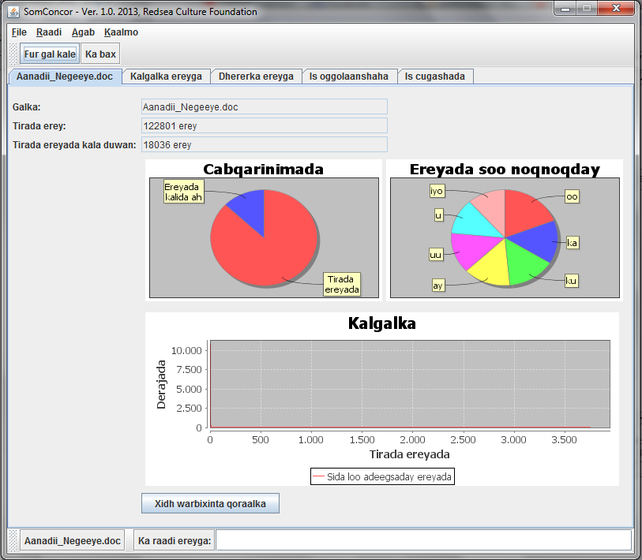
Interaction: tools for development
Notes:
Here it goes

Slide 81
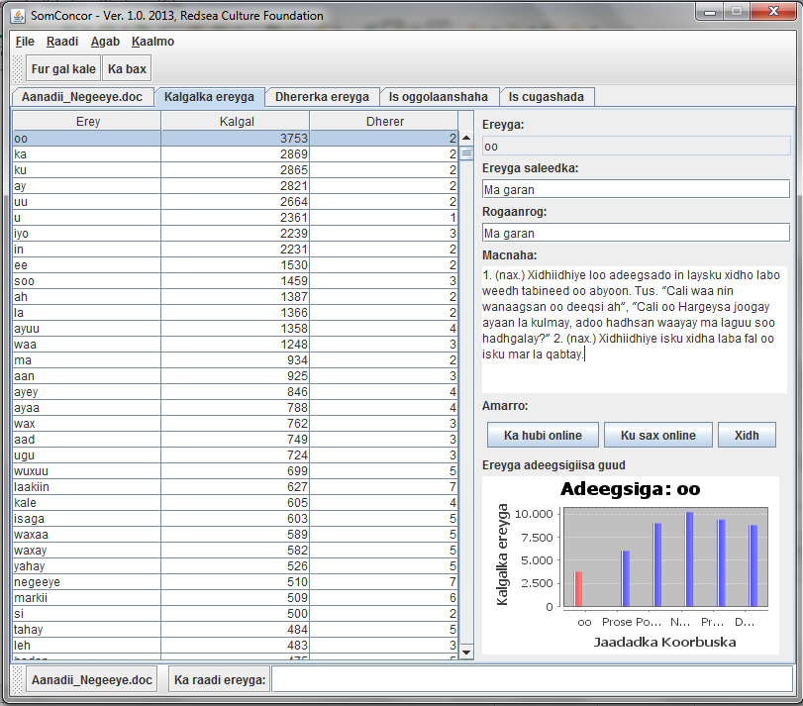
Interaction: tools for development
Notes:
Here it goes

Slide 82
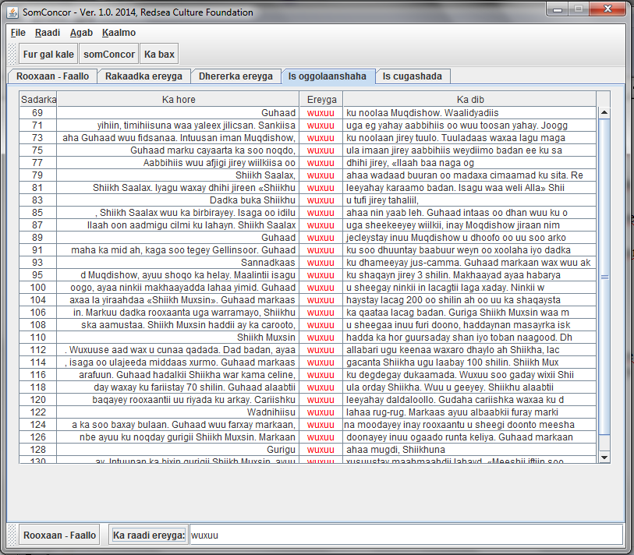
Interaction: tools for development
Notes:
Here it goes

Slide 83
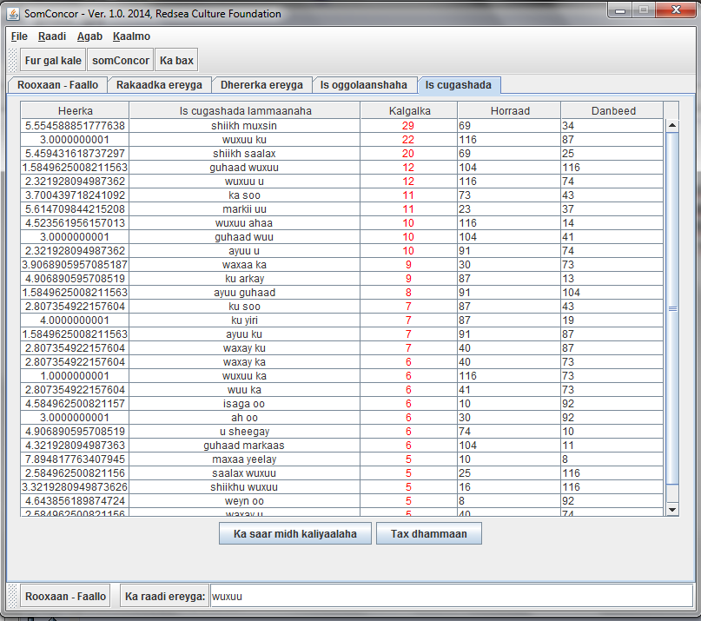
Interaction: tools for development
Notes:
Here it goes

Slide 84
Interaction: tools for development
www.somalicorpus.com
UserId: marti
Password: soor
_______________________________________
Jama Musse Jama | jama@jamamusse.com | 2017
Xarunta Dhaqanka ee Hargeysa | Hargeysa Cultural Centre
Notes:
Here it goes

Slide 85
Interaction: tools for development
_______________________________________
Jama Musse Jama | jama@jamamusse.com | 2017
Xarunta Dhaqanka ee Hargeysa | Hargeysa Cultural Centre
Notes:
Here it goes

Slide 86
Interaction: tools for development
_______________________________________
Jama Musse Jama | jama@jamamusse.com | 2017
Xarunta Dhaqanka ee Hargeysa | Hargeysa Cultural Centre
Notes:
Here it goes

Slide 87
Interaction: tools for development
_______________________________________
Jama Musse Jama | jama@jamamusse.com | 2017
Xarunta Dhaqanka ee Hargeysa | Hargeysa Cultural Centre
Notes:
Here it goes

Slide 88
Interaction: tools for development
_______________________________________
Jama Musse Jama | jama@jamamusse.com | 2017
Xarunta Dhaqanka ee Hargeysa | Hargeysa Cultural Centre
Notes:
Here it goes

Slide 89
Somaliland: a nation in transformation
Thank you
_______________________________________
Dr. Jama Musse Jama | jama@redsea-online.org| 2020 – twitter: @JamaMusse
Xarunta Dhaqanka ee Hargeysa | Hargeysa Cultural Centre
Notes:
There should be a reason to build a corpus. A single corpus cannot be valid for all reasons, and multi-purpose corpora always showed less helpful for the specific research in computational linguistics.

