Slide 1


IMPORTANCE OF
DATA PROTECTION

Slide 2
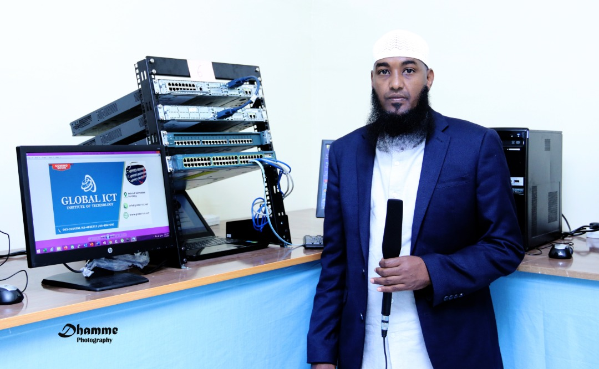
INSTRUCTOR PROFILE
Hamse Hayer (hayer@global-ict.net)
QUALIFICATION
(MSIS), Information Security (EH-Academy)
B-Tech in Networking Engineering (TU Dublin)
Cyber Security (Dorset College, Dublin)
INDUSTRIAL CERTIFICATION
CISSP (Certified Information System Security Professional).
CCNA Routing & Switching, CCNA Security, CCNP, Network Management, Hacking Android Devices, Ethical Hacking (pen tester). Offensive Security Certified Professional (OSCP) running.

Slide 3
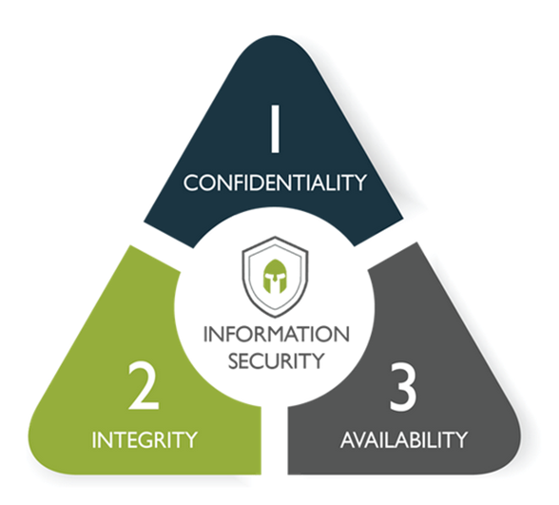
INTRODUCTION
Information security (infosec) is the practice of protecting information System by mitigating information risks.
Information security is designed to protect:
  Confidentiality,
  Integrity,
  Availability,
WHAT IS CYBERSECURITY?
Cybersecurity is a processes and practices designed to protection an organization's
Networks computers and data from unauthorized digital access by cyber criminals.

Slide 4
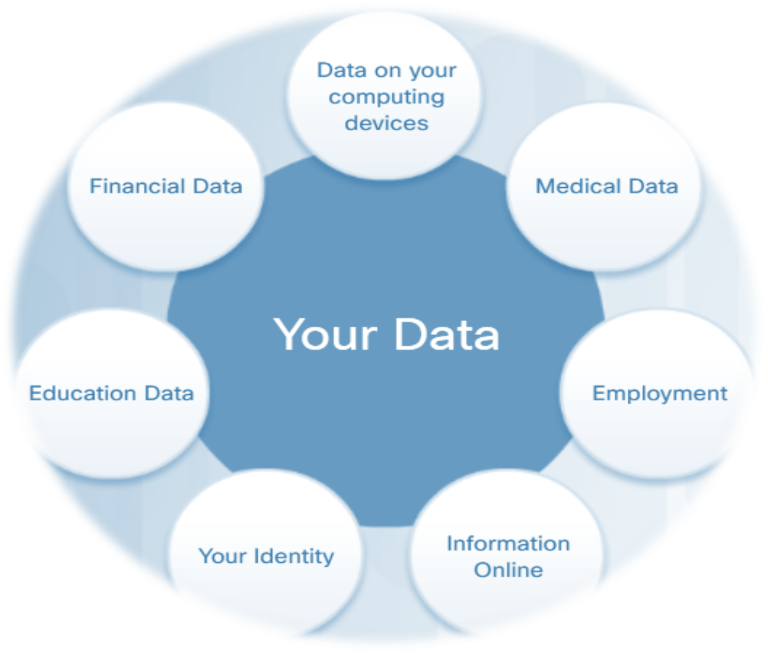
TYPES OF DATA
Data protection is the process of safeguarding important information from corruption, compromise or loss.
PERSONAL DATA
Online and Offline Identity
  Medical Records.
  Education Records.
  Banking statement.
ORGANIZATION OR COMPANY DATA
  Customer information.
  Intellectual property.

Slide 5
THREATS TO YOUR DATA
DIVIDED INTO TWO
  Insider threats.
  Outsider threats.
Insider threat
Insiders are trusted and use authorized login credential.
  Former employees change username and pass if remote
  Contractors change access if they use remotely.
  Employees baiting USB (Educate/training).
  Third party vendors (in government built their devices)

Slide 6

THREATS TO YOUR DATA
Outsider Threats
  Hackers.
  Cybercriminals individuals or teams of people commit malicious activities on digital systems or networks.
  Direct competitors are selling a similar product or service in the same category as you.
  State sponsor (cyberwarfare)
CYBER ATTACKS
  Malware Attacks (Trojan horse, viruses, Worms).
  Botnet Attacks (DDOS).
  Phishing Attacks, Spear Phishing.
  Sniffer – Man – the – middle Attack.

Slide 7
MITIGATE THE RISK
  Data Backup (most important)
  Data Encryption (resting /though the cables).
  DLP alert by admin Employees sending sensitive information
  Secure Your Computer (stick key, / change boot order /Bios password/physical access is total access) is there any foreign IP add connected to your computer?

Slide 8
MITIGATE THE RISK
  Use Strong Passwords (two factor authentication)
  Use Antivirus Software /Antimalware.
  Careful Use of Email and Website/phishing Emails or phishing links.
  Up to Date Operating System and Security patch.
  Educate Your Employees.
  Firewalls.

Slide 9
THANKS

